Slide 1
APPSHED
Create account

Slide 2
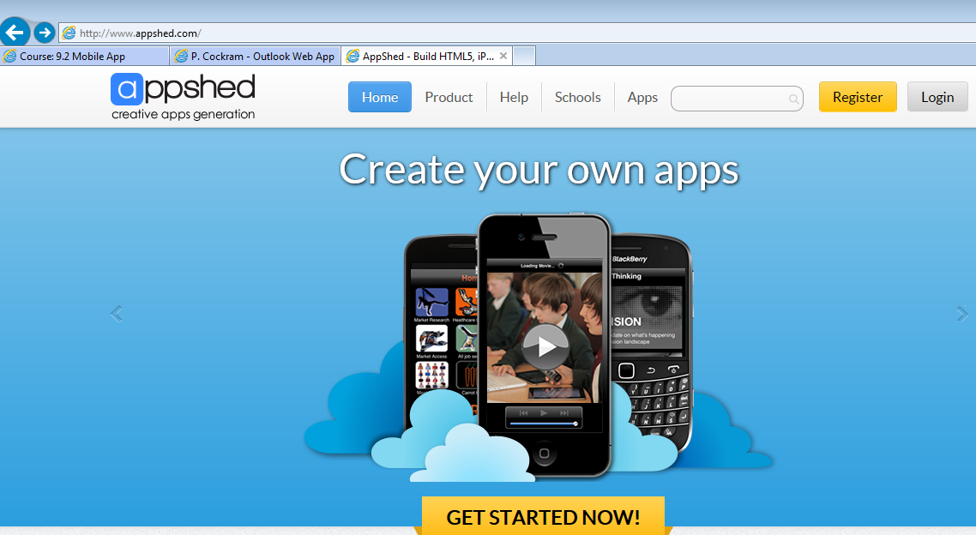
Find Appshed
Goto to URL www.appshed.com in your browser

Slide 3
Register for a logon
Select Register

Slide 4
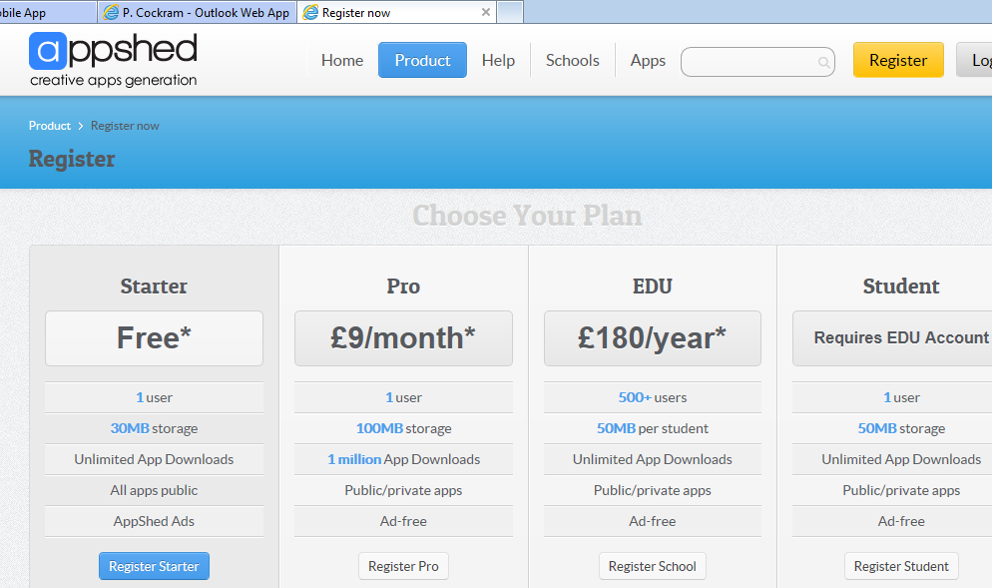
Choose Free Account

Slide 5
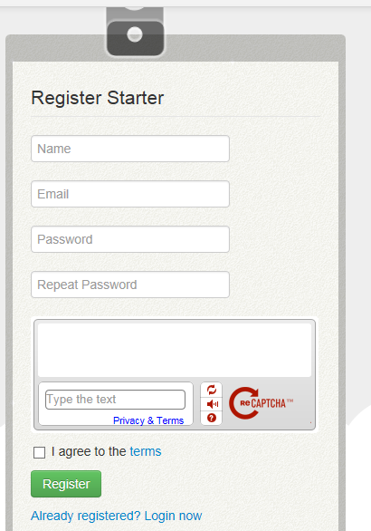
Complete Registration
Use your school email address
Your_name@archwayschool.net
NOTE:if Captcha picture does not appear
Keep pressing “I AGREE” and Register until you get a simple maths problem or count number of characters in your name question

Slide 6
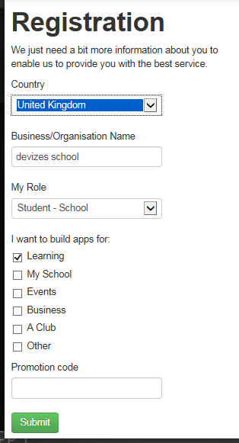
Complete Registration 1
Complete the items as per the screen shot and press SUBMIT
Done you now have an appshed account with which you can create mobile apps
Make a note of this in your planner
Username
password

Slide 7
Appshed – First Time
Make sure you select APPBUILDER
NOT Internet of Things

